Slide 1
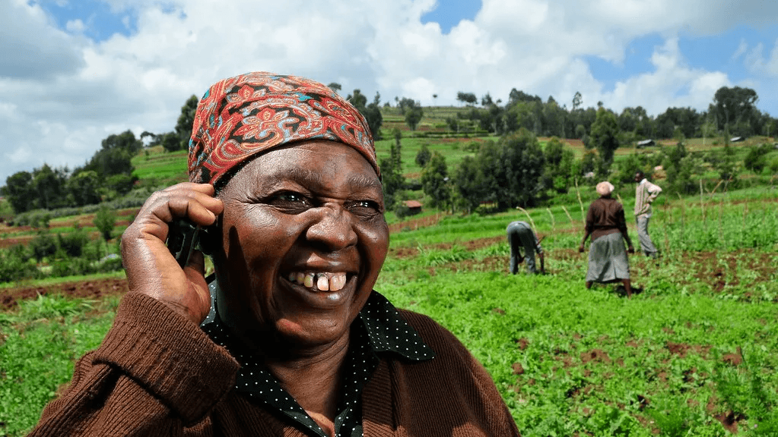

AgriLink Africa
AgriLink USSD System
Connecting Farmers to Information & Opportunity
2026 Strategic Overview
Mobile Agriculture Solutions

Slide 2
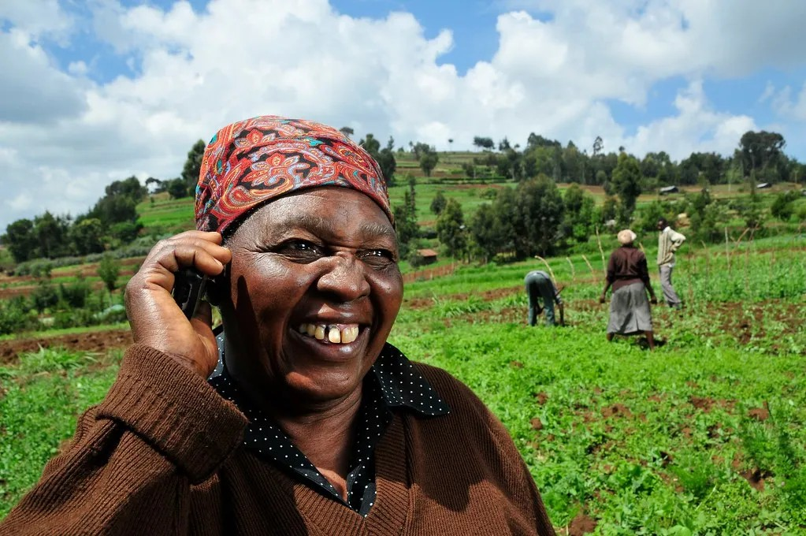






What is AgriLink USSD?
AgriLink is a revolutionary mobile-based information system designed specifically to empower farmers in low-connectivity and rural environments.
Operates using USSD technology, meaning it works on any basic phone without requiring internet access or a smartphone.
Connects disconnected farmers directly to vital market data, weather forecasts, and expert agricultural advice.
Supports better decision-making to improve productivity and reduce losses in rural communities.
02
AgriLink USSD System Overview

Slide 3







Why AgriLink USSD?
Our core objectives are focused on empowering rural communities through accessible technology.
Timely Information
Practical Advice
Market Access
Provide timely and reliable agricultural information directly to farmers when they need it most.
Support smallholder farmers with actionable farming advice to improve crop management.
Improve market access and price transparency to help farmers negotiate better deals.
Reduce Losses
Extend Services
Minimize crop and livestock losses due to pests, diseases, and unexpected weather shocks.
Extend critical agricultural advisory services to underserved and remote communities.
03
Purpose & Objectives

Slide 4
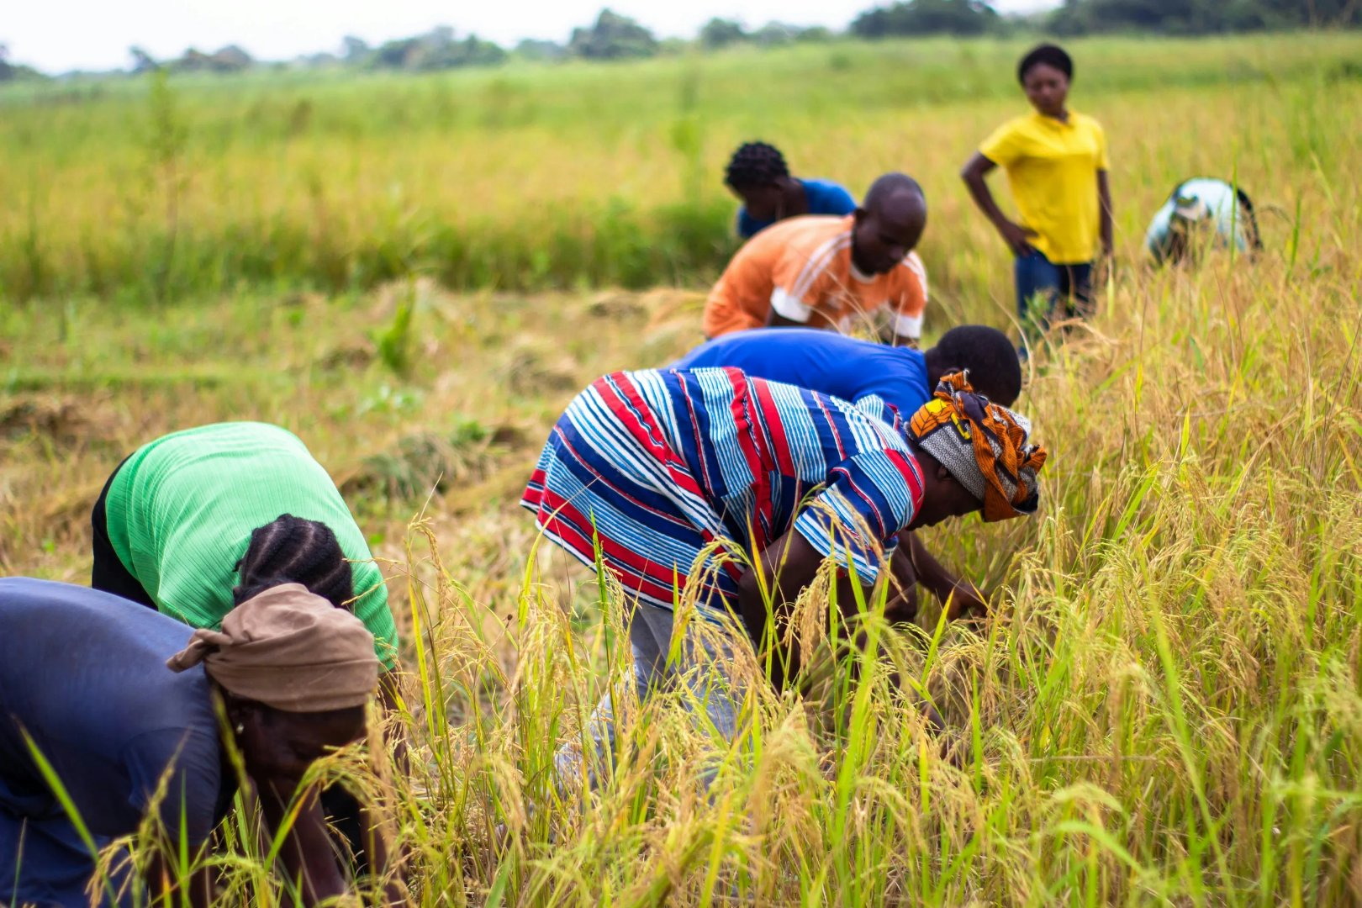









Who We Serve
INCLUSIVE ACCESS
Empowering diverse agricultural communities across the region.
Smallholder Crop Farmers
Livestock Keepers
Farmers using basic feature phones
Rural & Low-Connectivity Areas
Agricultural Cooperatives & Groups
04
Target Audience & Users

Slide 5






USSD Technology
AgriLink USSD
Simple, Powerful, Accessible
1. Crop Advisory
2. Livestock Tips
No Internet Required
3. Market Prices
Functions entirely on standard GSM voice signaling channels.
4. Weather Info
Works on 2G Networks
5. Inputs & Supplies
Accessible even in remote areas with basic signal coverage.
6. My Settings
Fast & Real-Time
7. Exit
Interactive menus with instant session-based responses.
Cost-Effective
Low cost or free to users, removing financial barriers.
Reply:
Access Code
*123#
05
Technology Overview

Slide 6




AgriLink Main Menu
AgriCell
3G
Comprehensive Agricultural Services at Your Fingertips
AgriLink Menu
1. Crop Advisory
Crop Advisory
Livestock Tips
1.
1
2
2. Livestock Tips
Planting guides & pest control
Health, feeding & vaccination
2.
3. Market Prices
3.
4. Weather Information
4.
3
Market Prices
4
Weather Info
5. Inputs & Fertilizers
5.
Live pricing by location
Forecasts & seasonal alerts
6. Extension Services
6.
7. Language & Settings
7.
Inputs & Fertilizers
Extension Services
8. Exit
5
6
8.
Usage guides & suppliers
Connect with officers
7
Language & Settings
8
Exit
Select option:
Personalize your experience
End session
_
Users simply reply with the corresponding number to access detailed sub-menus.
Cancel
Send
06
Menu Structure & Navigation

Slide 7







Crop Advisory Services
Actionable guidance for higher yields and sustainable farming
Planting Guide
Seed Varieties
Recommended planting periods tailored to local seasonal rainfall patterns.
Information on high-yield, drought-resistant, and climate-smart seed options.
Spacing & Methods
Fertilizer Application
Optimal crop spacing techniques to maximize density and land usage.
Precise guidance on fertilizer types and optimal application timing.
Pest ID
Control Measures
Simple descriptors to help farmers identify common pests and crop diseases.
Integrated pest management strategies and prevention tips.
"Delivered concisely via USSD screens to support better decision-making in the field."
Crop Advisory
07

Slide 8
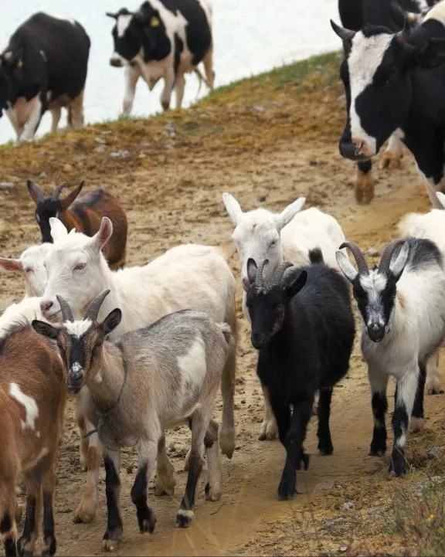






Livestock Support
Practical advice to improve herd health and productivity
Feeding Guidelines
Disease Prevention
Nutritional advice for different growth stages to maximize weight gain and health.
Early identification of symptoms and preventative measures for common diseases.
Vaccination Schedules
Housing & Hygiene
Timely alerts and calendars for essential livestock immunizations.
Best practices for constructing clean, safe, and ventilated animal shelters.
Basic Treatment
Mortality Reduction
First-aid guidance and simple remedies for treating minor ailments.
Strategies to minimize losses and improve overall survival rates.
"Helping farmers reduce livestock mortality and secure their primary assets."
Livestock Services
08

Slide 9
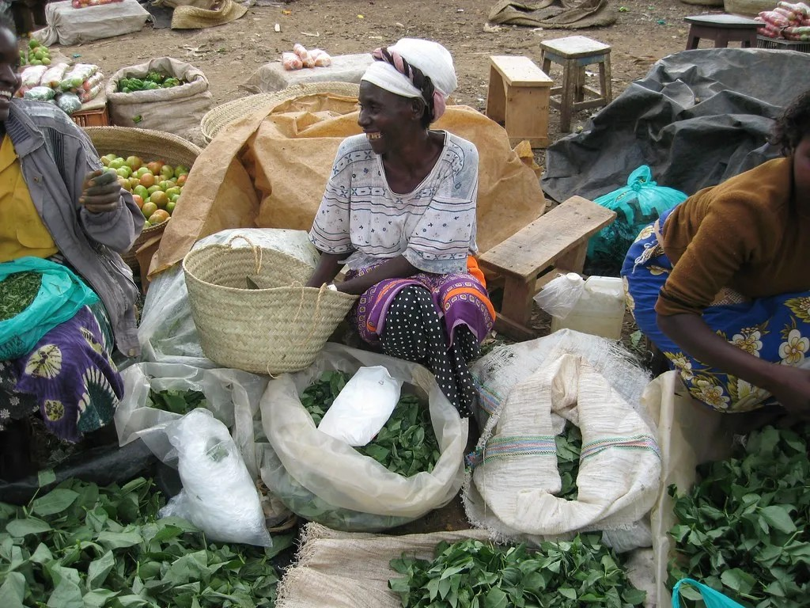







Market Information
Empowering farmers with price transparency and trends
Location Prices
Standard Units
Access current crop prices specific to your nearest local and regional markets.
View price breakdowns per kilogram or standard bag sizes for clarity.
Market Compare
Price Trends
Compare prices across different markets to find the best selling location.
Track basic price movements to identify seasonal highs and lows.
Buyer Connection
Demand Alerts
Information on verified buyers and collection centers in the region.
Notifications for high-demand crops to help plan harvesting schedules.
"Enabling farmers to negotiate better and choose the best time and place to sell."
Market Information
09

Slide 10





Weather Info & Input Guidance
Critical environmental data and resource management for better yields.
Weather Services
Inputs & Fertilizers
Rainfall Forecasts
Recommended Fertilizers
Short-term predictions to plan daily activities.
Crop-specific suggestions for maximum growth.
Dry Spell Alerts
Application Rates
Early warnings to implement water conservation.
Precise dosage instructions to avoid waste.
Flood Warnings
Approved Pesticides
Extreme weather alerts to protect crops and livestock.
Safe and effective pest control product lists.
Seasonal Outlooks
Safety Tips
Long-term summaries for strategic planting decisions.
Guidelines for safe handling and storage of chemicals.
Supplier Information
Locate nearby trusted input suppliers (where available).
10
Weather & Inputs

Slide 11
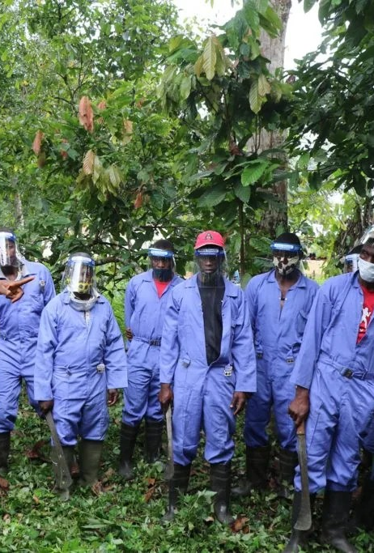










Extension Services & Support
Connecting farmers to human expertise and personalized care
Request Follow-up
Directly request a site visit or phone consultation from a local agricultural extension officer.
Report Outbreaks
Quickly report pests or disease symptoms to authorities for rapid community response.
Emergency Alerts
Receive broadcast warnings about floods, locust swarms, or extreme weather events.
Advisory Campaigns
Subscribe to seasonal educational campaigns for specific crops or livestock.
Language & Settings
Inclusive accessibility with Swahili, English, and local languages. Personalize alerts based on your specific crops and location.
11
Extension & Settings

Slide 12








Key Benefits of AgriLink
Delivering impact through accessible, affordable, and scalable technology.
No Internet Required
Basic Phone Access
Cost-Effective
Operates entirely on USSD technology, allowing farmers to access vital services without data plans or internet connectivity.
Fully accessible on basic feature phones, ensuring no farmer is left behind due to lack of expensive smartphones.
Provides an affordable solution for farmers with low transaction costs, making advisory services financially sustainable.
Nationwide Scalability
Enhances Productivity
Improves Resilience
Easily scalable across regions and countries using existing telecom infrastructure, reaching millions rapidly.
Directly contributes to higher yields and better resource management through timely, expert agricultural advice.
Strengthens farmers' ability to withstand climate and market shocks through early warnings and market intelligence.
12
Key Benefits

Slide 13






Current
Limitations
Limited Message Length
No Rich Media
USSD sessions are restricted to approximately 160-182 characters per screen. Information must be extremely concise, often requiring abbreviations.
The protocol is text-only. It cannot display images, videos, audio clips, or complex graphs, limiting visual aids for pest identification or demos.
While AgriLink USSD provides critical access, the technology has inherent constraints that influence content delivery and user experience.
Network Availability
Content Updates
Note to Stakeholders
"Transparency about these limitations allows us to design more effective, focused interventions."
Unlike offline apps, USSD requires an active GSM signal. Farmers in extremely remote "dead zones" cannot access the service in real-time.
Information is static until updated on the backend. Keeping market prices and weather alerts current requires consistent administrative effort.
13
System Limitations

Slide 14
Our Vision
“
AgriLink was born from a simple truth: when farmers are empowered, nations grow.
The Challenge
The Pathway
Bridging the gap for farmers who wake up before sunrise but lack access to information, markets, finance, and technology.
We are building more than a platform—we are creating a pathway where a smallholder farmer with a basic phone can make smarter decisions and earn better income.
14
Vision & Impact

Slide 15




Why Invest in AgriLink?
“
80%
Impact at Scale, Technology with Purpose
of food in Africa is produced by smallholder farmers.
More Than Returns
100%
An investment in sustainable growth and economic development rooted in real lives.
Committed to empowering their future.
Scalable Technology
Leveraging low-cost USSD infrastructure to reach millions without internet barriers.
Funding Resilience
Directly supporting food security and climate adaptation for underserved communities.
"Connecting those who grow our food to the future they deserve."
AgriLink USSD System
Investment Opportunity
15

Slide 16






AgriLink USSD
Join Us in
Transforming Agriculture
"Connecting those who grow our food to the future they deserve"
Email Us
info@nyikainnovations.co.tz
Call Us
+255 (0) 686 600 166
Visit Website
www.nyikainnovations.co.tz
© 2026 AgriLink Systems. All Rights Reserved.
Thank you for your time.

